Slide 1
UX Testing Introduction – Draft
Early Integration Team (EIT)
Ronnie Wong

Slide 2
Agenda
UX testing 101
User experiences
Method
Moderate and unmoderated
Resource
UX law
UX process
Geographical
UX and BT new test strategy
Tools
Certification

Slide 3
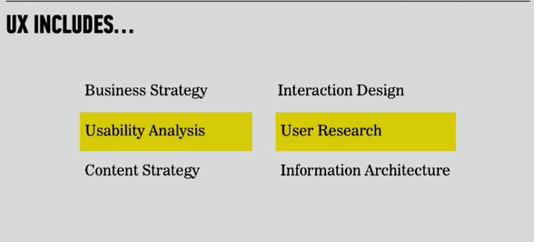
UX testing
User Experience testing has several names—UX Testing, usability testing, and user testing to name a few.
Purpose
It refer to the process of deep understanding what users do and why they do it.
Benefit
Usability testing lets the design and development teams identify problems much earlier and solved it
Promote rapid iterative development
Improve customer satisfaction (* Net Promoter Value)
Provide actionable data that Improve system performances
Enhance active communication between development and customers.

Slide 4
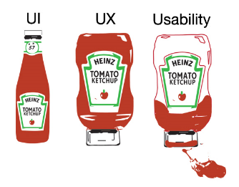
The ketchup experiences
The classic bottle of ketchup is the user interface.
The ketchup bottle introduced in 2002 with its characteristic inverted bottle and lid is supposed to be the user experience.

Slide 5
User Experience
User Experience - Satisfaction, enjoyment, pleasure, fun, value
Notes:
Five Element of UX
1) Psychology
The mind of a user is complex. You should know; you have one (I assume). UXers work with subjective thoughts & feelings a lot; they can make or break your results
2) Usability
If user psychology is mostly subconscious, usability is mostly conscious.
3) Design
As the UX designer, your definition of “design” will be much less artistic than a lot of designers. Whether you “like it” is irrelevant. In UX, design is how it works, and it’s something you can prove; it’s not a matter of style. Practical
4) Copywriting
5) Analysis

Slide 6
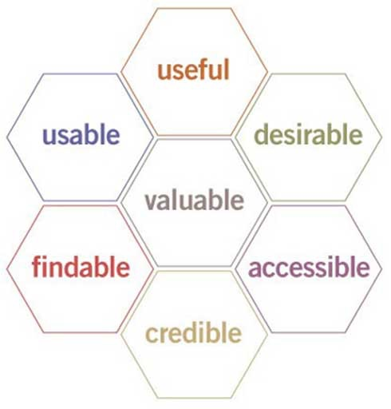
UX Law
Krug’s 3 laws of Usability - June 5, 2008
“Don’t make me think.”
“It doesn’t matter how many times I have to click, as long as each click is a mindless, unambiguous choice.”
“Get rid of half the words on each page, then get rid of half of what is left.”
Peter - User Experience Honeycomb or UX treasure map

Slide 7
User Experience Honeycomb
Useful: Your content should be original and fulfill a need
Usable: Site must be easy to use
Desirable: Image, identity, brand, and other design elements are used to evoke emotion and appreciation
Findable: Content needs to be navigable and locatable onsite and offsite
Accessible: Content needs to be accessible to people with disabilities
Credible: Users must trust and believe what you tell them
http://www.usability.gov/what-and-why/user-experience.html

Slide 8
UX process
Concept
Prototype
Validation internally
Validation Externally
Leaning
Sharing

Slide 9
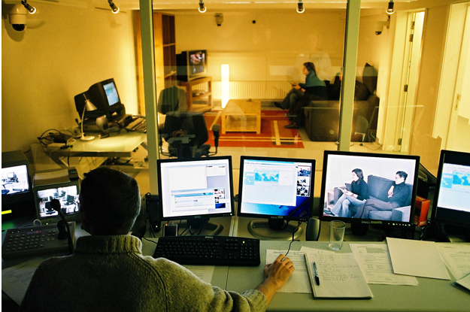
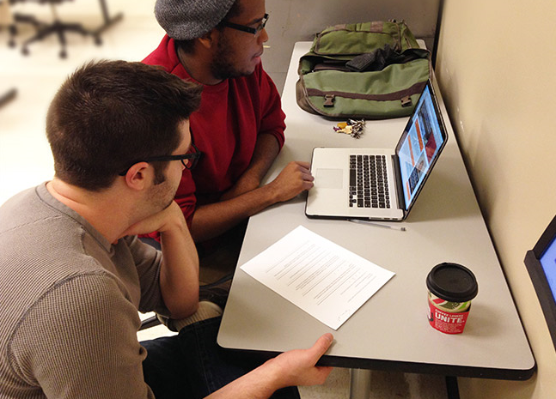
UX = User Experience
How it work ? traditional user testing involves individual test participants who are recruited to sit at a computer and be observed carrying out tasks that they are given.
The process of watching and listening to real people carry out these tasks provides a great insight into what works and what doesn't, and, critically—why

Slide 10
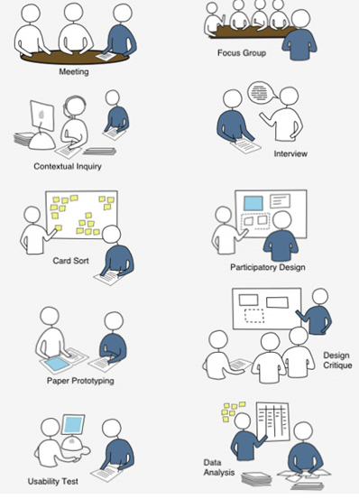
UX test method
Contextual inquiry
user mapping
card sort
Tree test
Preference testing
Design studios
Heuristic evaluation
A/B testing
User diaries
Surveys
Focus group

Slide 11
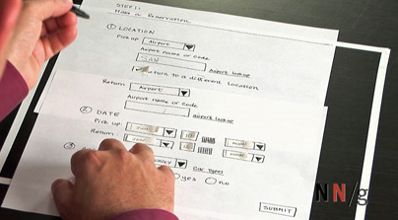
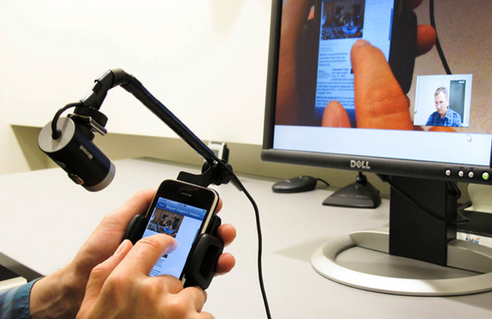
UX test method - Moderated In-Person Usability Testing
Moderated In-Person Usability Testing: This fundamental technique is used by usability professionals for obtaining feedback.
Technique like : Paper Porotype, Mobile usability testing .

Slide 12
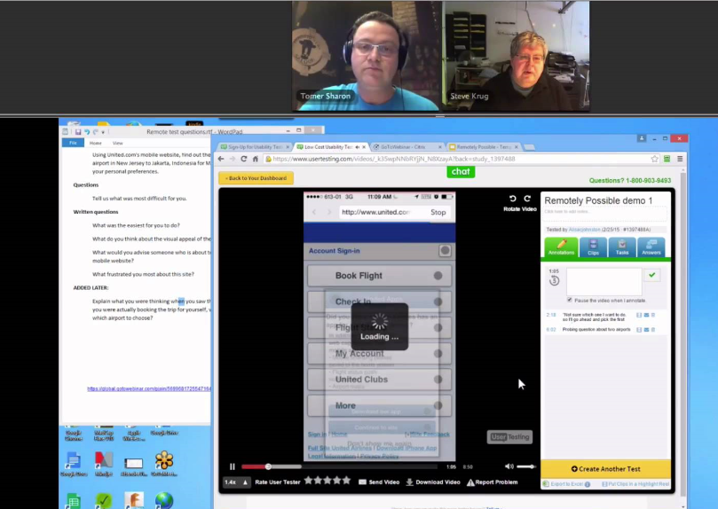
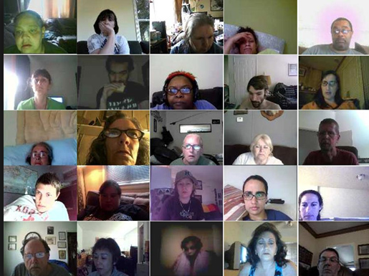
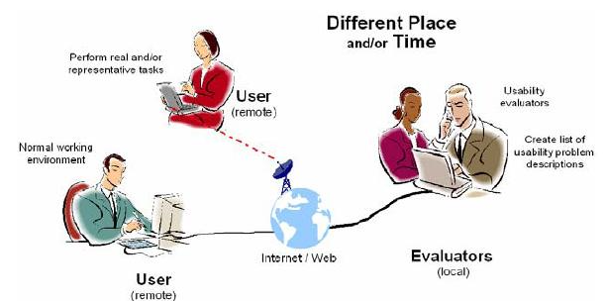
UX test method - Moderated Remote Usability Testing / Unmoderated Usability Testing
Moderated Remote Usability Testing: Interacting with participants and probing on comments and behaviors provides rich insights into users' motivations. The participant is around the globe with different of geographical location.
Work best with website, web application
Tool: Go Meeting, Loop, User Zoom

Slide 13
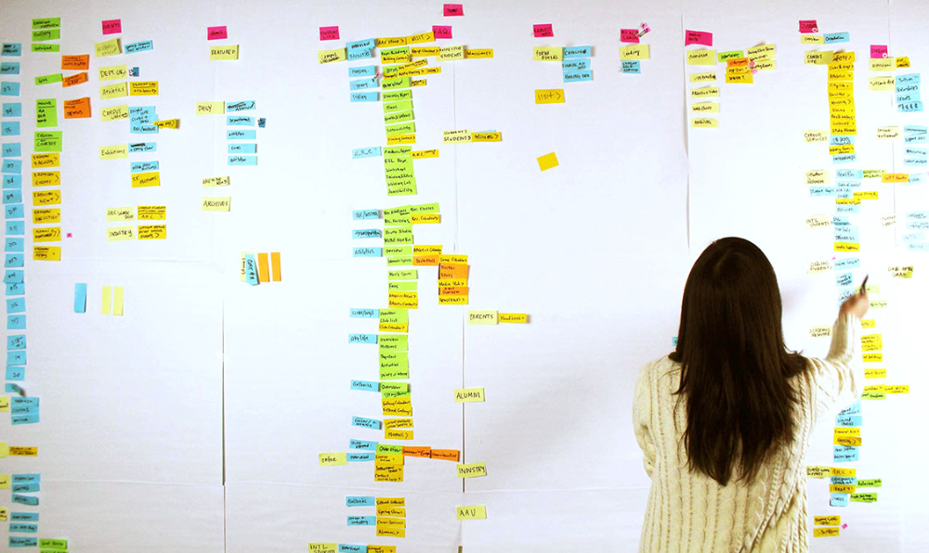
UX test method – Card sorting
Card Sorting involves having users (not designers, developers or VP's) sort a list of pages or categories together based on their understanding of the structure and relationship.
Develop a user centric taxonomy of group, sorting, navigate to form a solution. (UserZoom and OptimalWorkshop. )

Slide 14
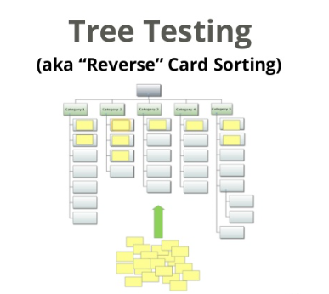
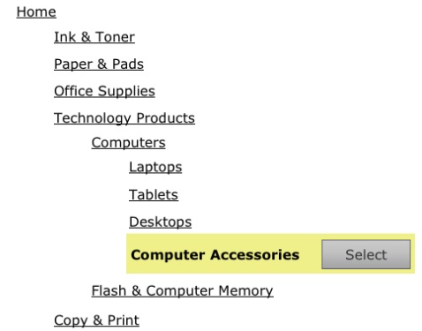
UX test method – Tree Testing
Tree testing is sometimes referred to as reverse card sorting since you are finding items instead of placing them into a navigation structure (often called taxonomy).

Slide 15
UX test method – Voice of Customer
Surveys are an efficient and cost effective way of understanding who users are and what they are trying to accomplish on websites or software.
This is through emailing question .

Slide 16
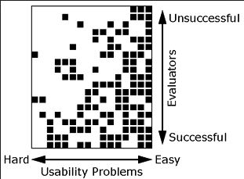
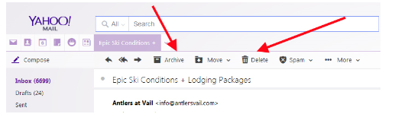

UX test method – Heuristic Evaluation / Expert Review
With a set of tasks, user profiles, and a set of interface guidelines (called heuristics), researchers can identify many of the problems users will likely encounter during a usability test and in actual use of an application
Notes:
Heuristic evaluations are one of the "discount" usability methods introduced over 20 years ago by Jakob Nielsen and Rolf Molich. In theory, a heuristic evaluation involves
Understand the Method & Human Behaviour having a trained usability expert inspect an interface with compliance to a set of guiding principles (heuristics), such as Nielsen's 10 heuristics
Have Some Idea of Common Tasks Users Will Perform
Have Another Expert Perform an Independent Review
Categorize, Reconcile Differences, and Add Severity

Slide 17
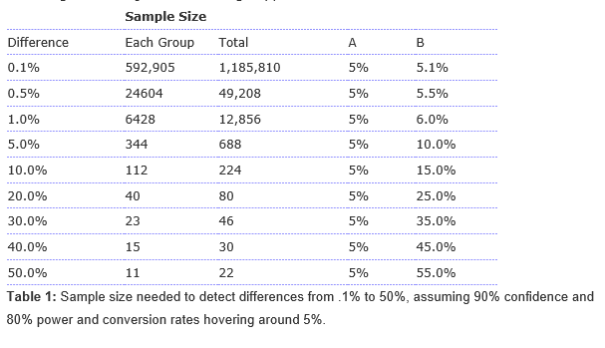
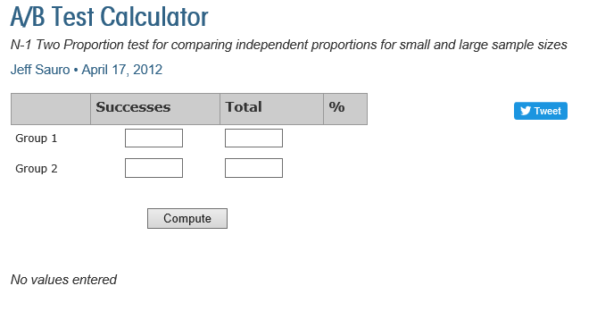
UX test method – A/B Testing
A and B refer to Alternate Versions: A/B testing is often called split-testing as you split a sample of users where half use one version, arbitrarily called A, and the other half use the other version, arbitrarily called B.

Slide 18
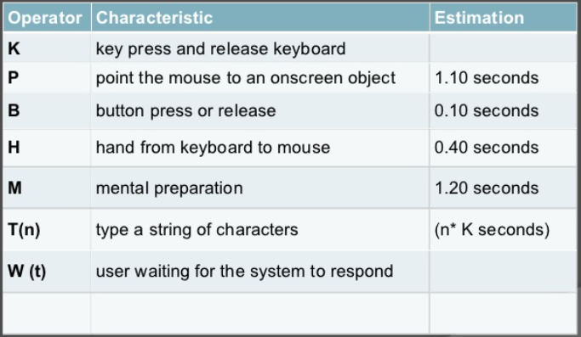
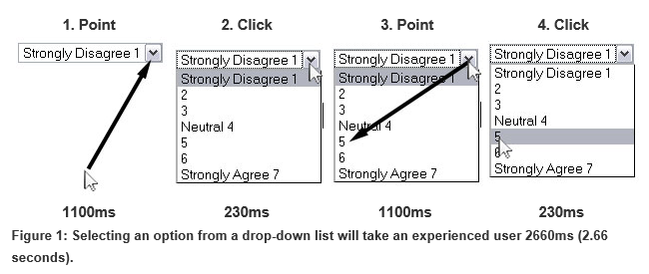
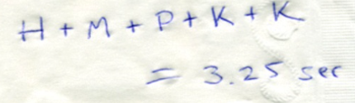
UX test method - Keystroke Level Modeling:
The Keystroke-Level Model (KLM) predicts how long it will take an expert user to accomplish a routine task without errors using an interactive computer system
Notes:
The Keystroke-Level Model consists of six operators: the first four are physical motor operators followed by one mental operator and one system response operator:^{[5]}
K (keystroke or button press): it is the most frequent operator and means keys and not characters (so e.g. pressing SHIFT is a separate K operation). The time for this operator depends on the motor skills of the user and is determined by one-minute typing tests, where the total test time is divided by the total number of non-error keystrokes
P (pointing to a target on a display with a mouse): this time differs depending on the distance to the target and the size of the target,^{[6]} but is held constant. A mouse click is not contained and counts as a separate K operation.
H (homing the hand(s) on the keyboard or other device): This includes movement between any two devices as well as the fine positioning of the hand.
D (drawing (manually) n_{D} straight-line segments with a total length of D(n_{D}, l_{D}) cm): where n_{D} is the number of the line segments drawn and l_{D} is the total length of the line segments..
M (mentally preparing for executing physical actions): denotes the time a user needs for thinking or decision making. The number of Ms in a method depends on the knowledge and skill of the user. Heuristics are given to help decide where an M should be placed in a method. For example, when pointing with the mouse a button press is usually fully anticipated and no M is needed between both operators.^{[7]} The following table shows the heuristics for placing the M operator:^{[8]\\}
R (response time of the system): the response time depends on the system, the command and the context of the command. It only used when the user actually has to wait for the system. For instance, when the user mentally prepares (M) for executing his next physical action only the non-overlapping part of the response time is needed for R because the user uses the response time for the M operation (e.g. R of 2 seconds – M of 1.35 seconds = R of .65 seconds). To make things clearer, Kieras ^{[9]} suggests the naming waiting time (W) instead of response time (R) to avoid confusion. Sauro suggests taking a sample of the system response time
When interface efficiency is important you'll want to measure how much a new design can improve task times. You can actually estimate time saved (or lost) using some well tested approaches that are based on average human performance for typical computer based operations like clicking, pointing and typing

Slide 19
Key automation characteristic and consideration
Recording & Play – video , Images, voice, keystrokes, mouse movements, feedback and screen action.
Support moderate and unmoderated
Setup up test task, question scenario with instruction.
Automated recruit test subject by provide link, advertisement and send invitation.
Support analyze result.
Heatmap
Hotspot
Gaze Saccades (Simulation about eye movement)
Report, statistic and dashboard.

Slide 20
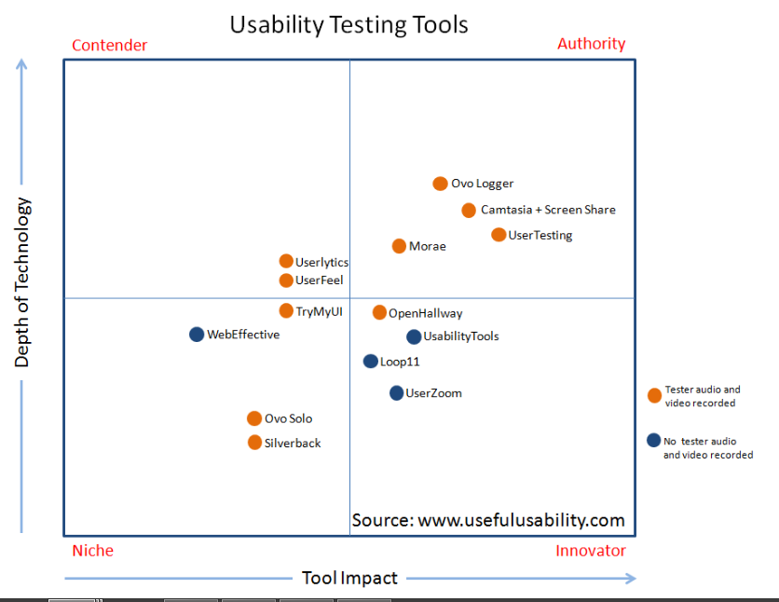
Tool in the market
Tools are those that provide a greater amount of usability testing functionality as well as a higher potential impact on discovering, diagnosing and ultimately optimizing the user experience
Tools have the ability to provide a greater impact in terms of their depth of technology, but may have more limited potential impact in discovering, diagnosing and optimizing the user experience
Tools have a more limited depth of technology, but have the potential to have a greater impact in usability testing and recommendations
Tools have a relatively limited depth of technology as well as a lower potential impact on usability testing and recommendations results, but can still be very useful for the specific tasks they were created for
http://www.usefulusability.com/14-usability-testing-tools-matrix-and-comprehensive-reviews/

Slide 21
Can we perform this kind of testing ?
How this test can assist in preparing our new test strategy?
How to perform UX test in EIT?
Some challenges
Real user ? Who? And Where? (Internal (people use the application) and external (Customer))
Resource (Resource, tools, labs)
Process
Journey guru
Take a tool to simulate

Slide 22

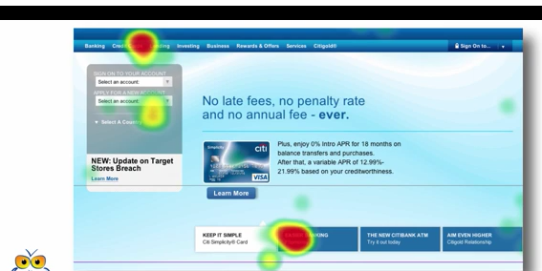
Idea how we going to involved
Participants
Journey guru (Biz user, * User experience officer)
UX Method
Tool
Internal user from different LOB
Unmoderated remote, card sorting, tree testing
Optimal workshop
User Zoom
Component (Portal)
WCDS
SaaS
Output
Dashboard
Dendrogram
Similarity matrix
Heat map
Hotspot
SI *
Notes:
Component involved WCDS, SaaS
Participant : Journey guru ( Biz user, *User Experiences officer), Internal user from different LOB.
UX method : Unmoderated remote usability testing, Keystroke level model (KLM), Card sorting (https://www.optimalworkshop.com/optimalsort)
Tool :
Optimal workshop (https://www.optimalworkshop.com/optimalsort)
User Zoom (http://www.userzoom.com/)
Card Sorting (group the data)
Tree Testing
Screenshot Click Testing (heat map)

Slide 23
Certification
BT ALP ? I am still looking
Certification
Certified Usability Analyst (CUA)™ Track
Certified advanced professional (CXA) Track
http://www.humanfactors.com/training/index.asp
ISTQB – Soon http://www.istqb.org/
Mooc
https://www.open2study.com/courses/user-experience-for-the-web
http://mooc.live/ux-research-make-better-products-with-usability-testing-online-course/

Slide 24

Q & A

Slide 25
Important Link
http://remoteresear.ch/tools/
http://www.usefulusability.com/24-usability-testing-tools/
http://www.usefulusability.com/14-usability-testing-tools-matrix-and-comprehensive-reviews/

Slide 26
Tool in the market
Authority tools are those that provide a greater amount of usability testing functionality as well as a higher potential impact on discovering, diagnosing and ultimately optimizing the user experience.
Contender tools have the ability to provide a greater impact in terms of their depth of technology, but may have more limited potential impact in discovering, diagnosing and optimizing the user experience
Innovator tools have a more limited depth of technology, but have the potential to have a greater impact in usability testing and recommendations
Niche tools have a relatively limited depth of technology as well as a lower potential impact on usability testing and recommendations results, but can still be very useful for the specific tasks they were created for
http://www.usefulusability.com/14-usability-testing-tools-matrix-and-comprehensive-reviews/

